Slide 1

How to be a command line hacker :
Shell Scripting

Slide 2
What I s the Shell?
The shell is
a program that takes keyboard commands
and passes them to the operating system to
carry out. Almost all Linux distributions supply a shell
program from the GNU Project called bash.
The name is an acronym for bourne-again shell, a reference to the
fact that bash is an enhanced replacement for sh, the
original Unix shell program written by Steve Bourne.

Slide 3

Terminal Emulators
When using a graphical user interface (GUI), we need another program
called a terminal emulator to interact with the shell.

Slide 4
Get know some basic Terminologies!
Standard files.
Std-IP
Std-OP
Std-E
Command History
Cursor Movement
Then
Learn to Ending a Terminal Session
Using exit

Slide 5
What Exactly Are Commands?
A command can be one of four different things.
• An executable program like all those files we saw in /usr/bin. Within this
category, programs can be compiled binaries such as programs written in
C and C++, or programs written in scripting languages such as the shell,
Perl, Python, Ruby, and so on.
• A command built into the shell itself. bash supports a number of commands
internally called shell builtins. The cd command, for example, is a
shell builtin.
• A shell function. Shell functions are miniature shell scripts incorporated
into the environment. We will cover configuring the environment
and writing shell functions in later chapters, but for now, just be aware
that they exist.

Slide 6
What is Directories!
a Unix-like operating system such as Linux organizes its files
in what is called a hierarchical directory structure. This means they are organized
in a tree-like pattern of directories (sometimes called folders in other
systems), which may contain files and other directories. The first directory
in the file system is called the root directory. The root directory contains files
and subdirectories, which contain more files and subdirectories, and so on.

Slide 7
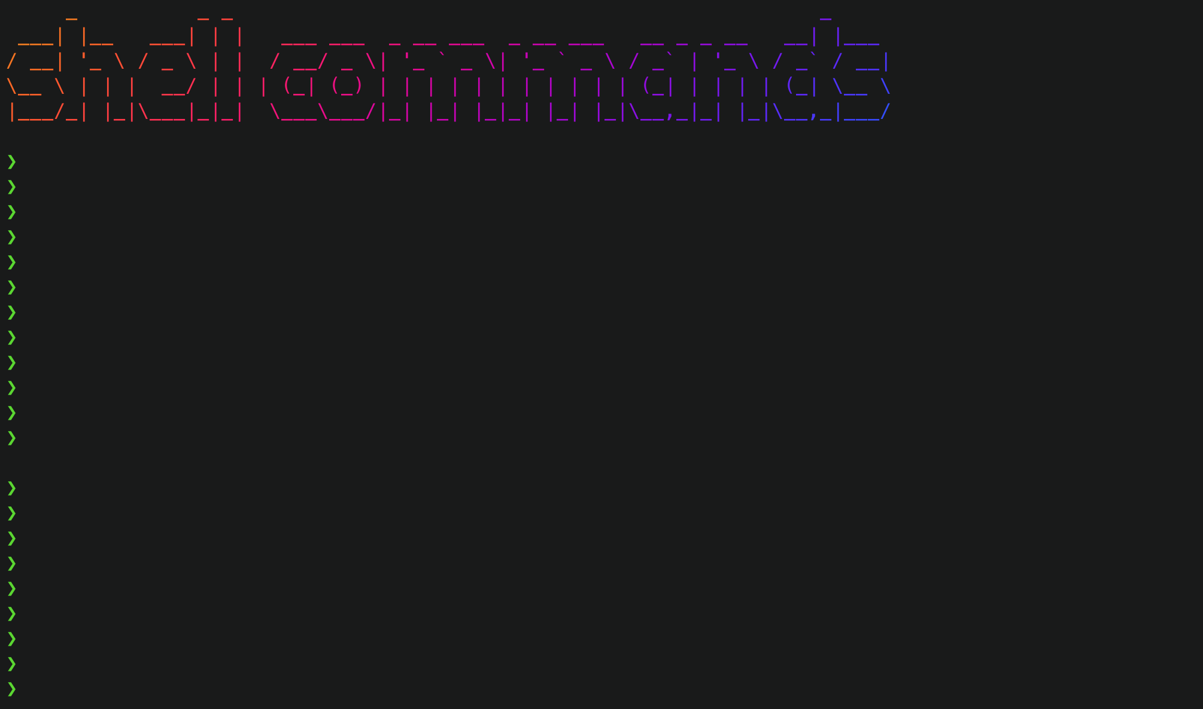
Learn some Commands….

Slide 8
Some very basic and useful!
Pwd - current working dir
Whoami - current user(name)
Data - current data and time
History - all shell history
Cp - copy
Rm - remove
Clear - clear the shell interface
Man - manuals
Exit- close the session
Who - logged in history
Mkdir - make dir
Cat - concate files
Mv - move
Alias - create/combine multiple command
Echo - print on std op
Ls - listing contents

Slide 9
echo command
Used to print output on the std op by default.
Syantx
echo <object>
grep command
The grep utility searches any given input files, selecting lines that match one or more patterns.
Grep comes with some built in attributes to make work efficient.
Ex - grep -n/-a <pattern> <file>

Slide 10
More about ls command.
Tip : Always Use man <command> to learn more.
Common ls Options Option Long option Description
-a --all List all files, even those with names that begin with a period, which are normally not listed (that is, hidden).
-A --almost-all Like the -a option except it does not list . (current directory) and .. (parent directory).
-d --directory Ordinarily,if a directory is specified, ls will list the
contents of the directory, not the directory itself. Use this
option in conjunction with the -l option to see details
about the directory rather than its contents.
-F --classify This option will append an indicator character to the
end of each listed name. For example, it will append a
forward slash (/) if the name is a directory.
-h --human-readable In long format listings, display file sizes in humanreadable
format rather than in bytes.
-l Display results in long format.
-r --reverse Display the results in reverse order. Normally, ls displays its results in ascending alphabetical order.
-S Sort results by file size.
-t Sort by modification time.

Slide 11
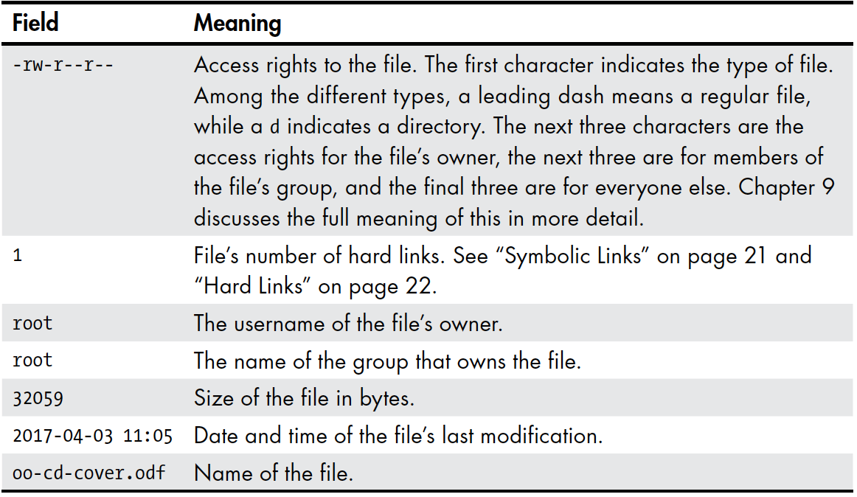
ls Long Listing -> ls -l

Slide 12
Manipulating Files and Directories
cp - Copy files and directories
mv - Move/rename files and directories
mkdir - Create directories
rm - Remove files and directories
Learn more about rm && cp && mv to get more of your system!
Use `man`

Slide 13
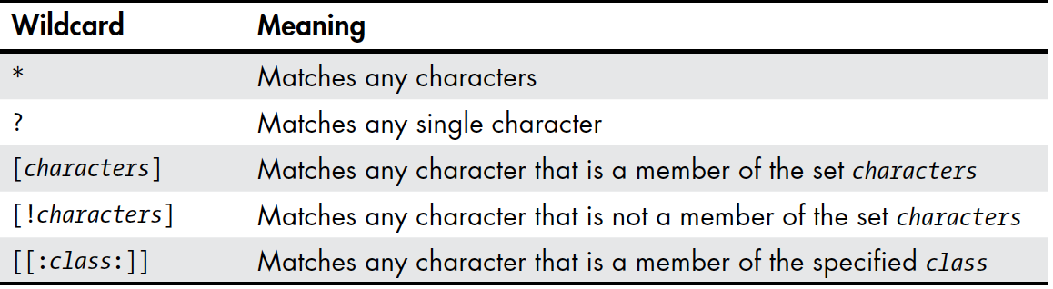
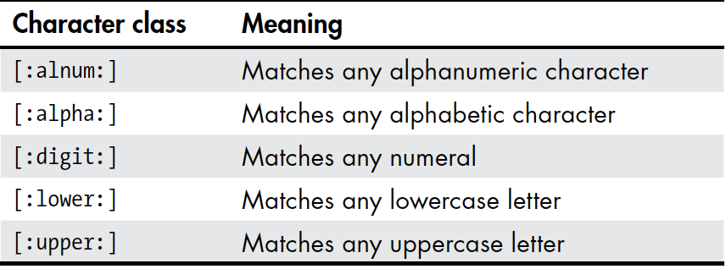
Wildcards in commands

Slide 14
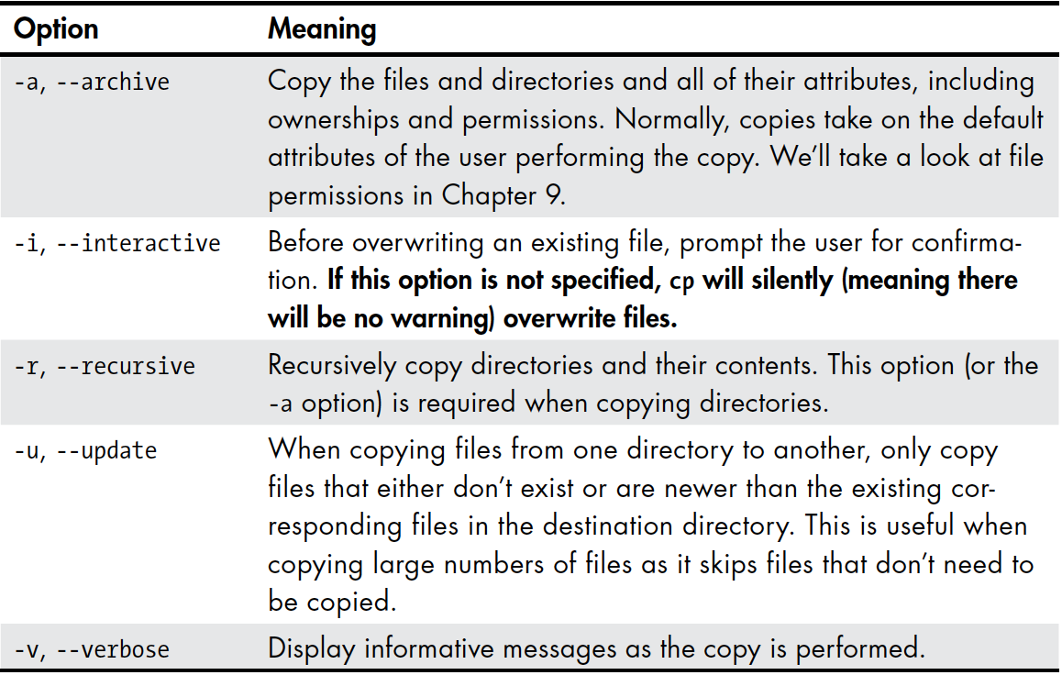
cp - copy command and its attributes.

Slide 15
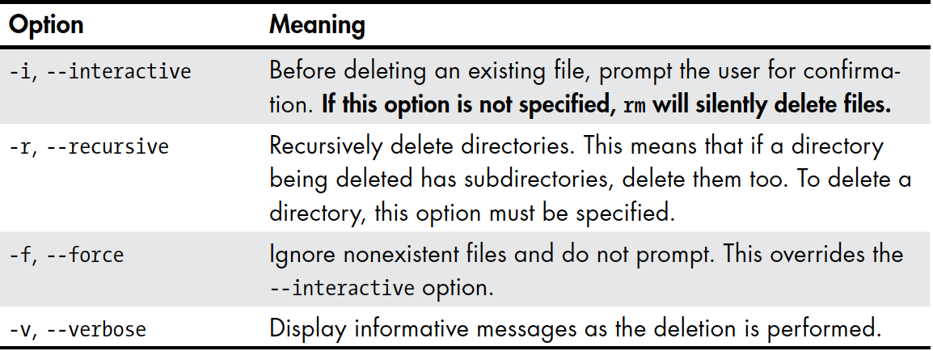
Rm- remove command and some attributes

Slide 16
Redirection
It’s called I/O redirection
widely Used with
cat Concatenate files
sort Sort lines of text
uniq Report or omit repeated lines
grep Print lines matching a pattern
wc Print newline, word, and byte counts for each file
head Output the first part of a file
tail Output the last part of a file
tee Read from standard input and write to standard output and files

Slide 17
Redirecting Standard Output
I/O redirection allows us to redefine where standard output goes. To
redirect standard output to another file instead of the screen, we use the >
redirection operator followed by the name of the file.

Slide 18
Redirecting Standard Error
Redirecting standard error lacks the ease of a dedicated redirection operator.
To redirect standard error, we must refer to its file descriptor. A program
can produce output on any of several numbered file streams.

Slide 19
Redirecting Standard Output and Standard Error to One File
There are cases in which we may want to capture all of the output of a command
to a single file. To do this, we must redirect both standard output and
standard error at the same time.

Slide 20
Redirecting Standard Input
There are cases in which we may want to get all the input from shell interface or from a
to a single file. To do this, we must redirect both standard input using “<”.

Slide 21
Pipelines
The capability of commands to read data from standard input and send to
standard output is utilized by a shell feature called pipelines. Using the pipe
operator |, the standard output of one command can be piped into the standard
input of another.

Slide 22
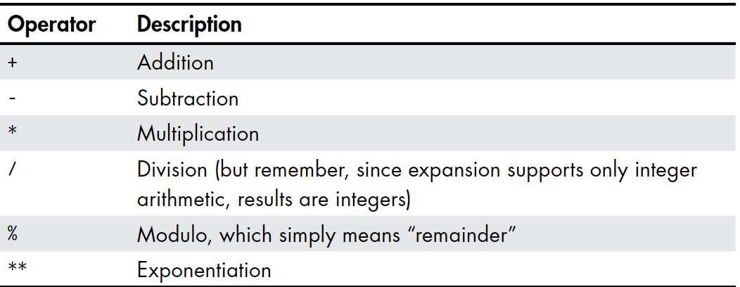
Arithmetic operations

Slide 23
Permissions
chmod Change a file’s mode
su Run a shell as another user
sudo Execute a command as another user

Slide 24
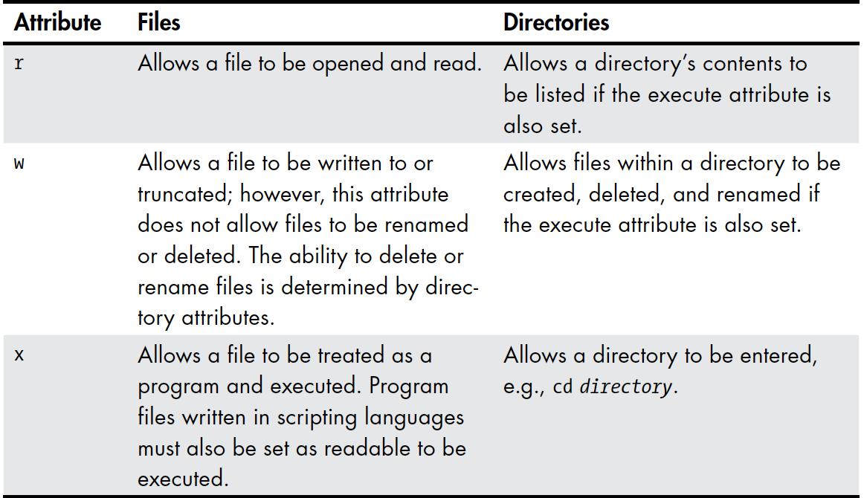
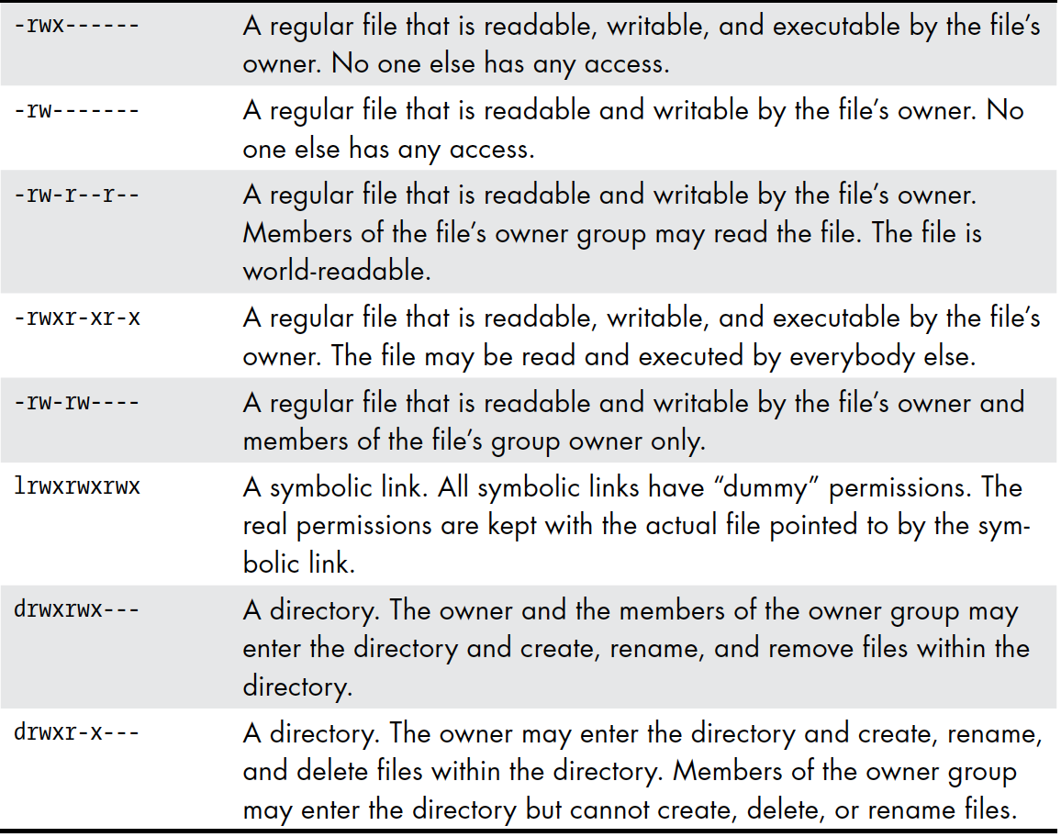
Permission Attribute

Slide 25
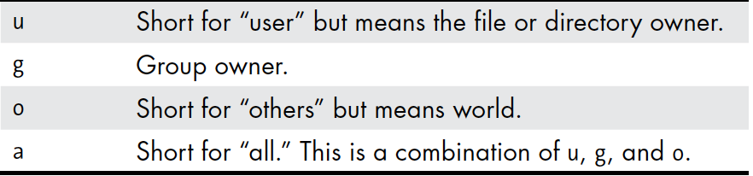
Symbolic Notations

Slide 26
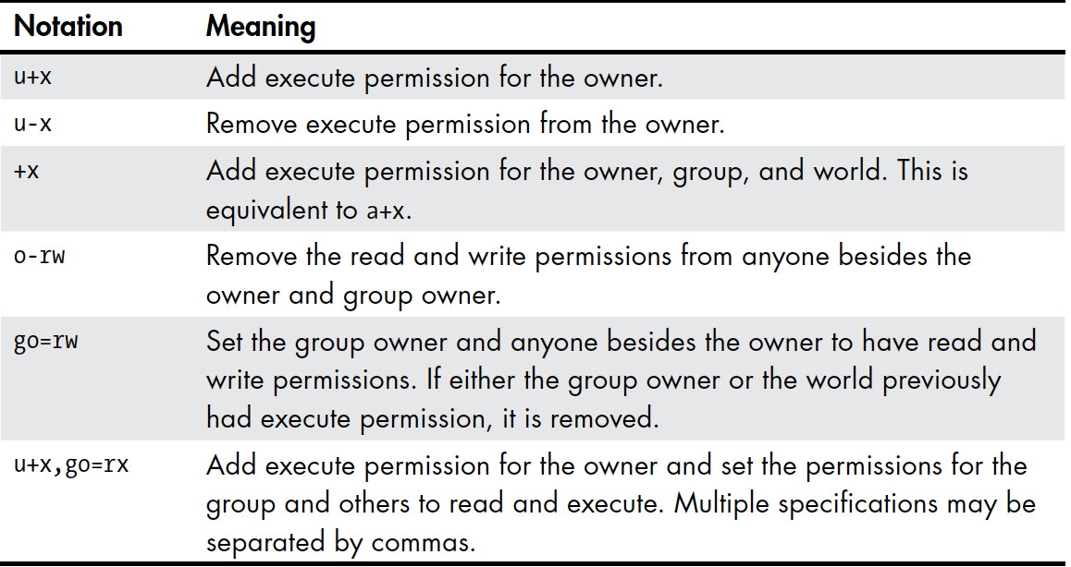

Slide 27
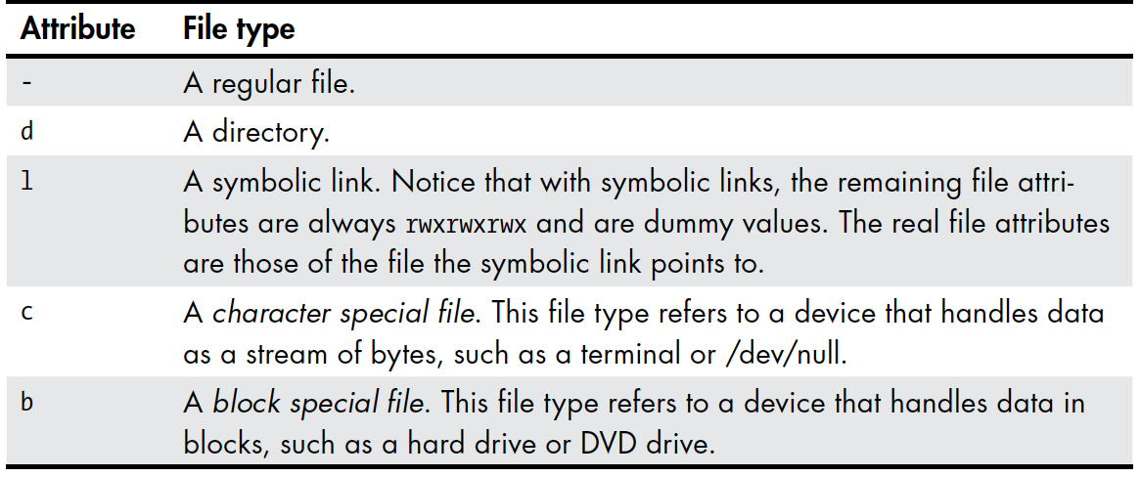
Some file decriptions/types

Slide 28
Shell Scripting.
How to Write a Shell Script
To successfully create and run a shell script, we need to do three things.
1. Write a script. Shell scripts are ordinary text files. So, we need a text
editor to write them. The best text editors will provide syntax highlighting,
allowing us to see a color-coded view of the elements of the script. Syntax
highlighting will help us spot certain kinds of common errors. vim, gedit,
kate, and many other editors are good candidates for writing scripts.
2. Make the script executable. The system is rather fussy about not letting
any old text file be treated as a program, and for good reason! We need
to set the script file’s permissions to allow execution. chmod 755
3. Put the script somewhere the shell can find it. The shell automatically
searches certain directories for executable files when no explicit pathname
is specified. For maximum convenience, we will place our scripts
in these directories.
“ALL SHELL SCRIPS MUST HAVE SHEBANG `#!/bin/<shellname>`”

Slide 29
Conditionals (if -elif-else)
I f [ expresion]
Then
Statements
eli f [ expresion]
Then
Statements
Else
Statements
If # this is important
NOTE: All conditions/expr must be in sq. brackets.

Slide 30
File conditons
-d : check if given path/object is dir
-f : check if given path/object is file
-e :check if given path/object exist
*True on success and False on failure

Slide 31
Loops and Iterations
While loop
Syntax:
While [ expr]
Do
statements
done

Slide 32
Foe loop
For i in <series> # it can be like 1 2 3 4 OR {<start>:<end>:<step>}
Do
Statements
Done
There are other loops too :
Until loop
Select loop

Slide 33
Exection of Shell cmds on a script
User the syntax
( <a valid command >)
To store/extract op:
<a valid var>=$(<a valid command >)

Slide 34
Evaluation operation and syntaxs
-lt - less than
-mt - more than
-eq - equality
-ne - not equal
-a / && - logical and
-o / || - logical or
To evaluate a mathematiocal expr :
$(( < var > <opertaion> <var>))
Eg: c=$((${a}+${b}))
OR
`expr <valid operation>`

